Slide 1


Vision™ Document
Created by Clayton Warstler, Ethan Castleman, Travis Clark, Cameron Evans, and Nathanael McClure
SwaB™

Slide 2

Executive Summary
The purpose of this project is to design and implement a secure, centralized Inventory Tracking System that allows the Internal Audit department at Buzzword Software Solutions Limited to manage and monitor all company-owned physical assets, such as servers, laptops, and other electronic resources.
This system will ensure that all asset data exists in a single source, improving accuracy, accountability, and ease of access for both employees and managers.

Slide 3
Business Context
Background: Buzzword Software Solutions Limited Internal Audit Department has requested a software system to manage the physical assets of the company.
Opportunity: A single source to track the servers, employee laptops, and other electronic assets.
Goals & Objectives (Use Case):
The ability to query resource details
The ability to add/update/delete resources single or multiple
The ability to group resources by type
The ability to assign resources to employees and locations

Slide 4

Vision™ Statement
“To create a secure, scalable, and user-friendly system that empowers Buzzword Software Solutions to efficiently track, assign, and manage all company assets. With a goal of reducing audit risk, simplifying reporting, and enhancing transparency across the organization.”

Slide 5

Customer or Market Needs
Target Users
What problems are they facing?
Managers
Employees
A decentralized system to check where resources and assets are located and being used.

Slide 6
Proposed Solution
The proposed solution is a secure, centralized Inventory Tracking System designed as a backend service using a RESTful API architecture. This system will serve as the single source of truth for managing all company-owned physical assets across Buzzword Software Solutions Limited's global offices.
The system will allow authorized users, primarily managers and internal audit staff, to perform full lifecycle management of assets, including adding, updating, deleting, grouping, and assigning resources. Employees will have read-only access to view assets assigned to them or query general resource information.
The backend will be built with a security-first approach, incorporating role-based access control, audit logging, and data protection mechanisms. No frontend UI will be developed in this phase; instead, the system will expose a well-documented REST API for integration with other internal tools or future frontend development.
REST API for resource management
Enables CRUD operations on individual or grouped assets via secure endpoints.
Resource assignment
Assets can be assigned to employees or physical locations, supporting both static and mobile resources.
Search and Query Capabilities
Resources can be searched by type, location, employee, or other metadata.
Role-Based Permissions
Managers can modify data; employees can view assigned assets.
Audit Logging
Tracks all changes for compliance and accountability.
Security and Privacy
Includes authentication, authorization, and hidden sensitive fields.
Categorization and Metadata
Resources are grouped by type and include critical fields like acquisition date, location, and formatted resource ID.

Slide 7
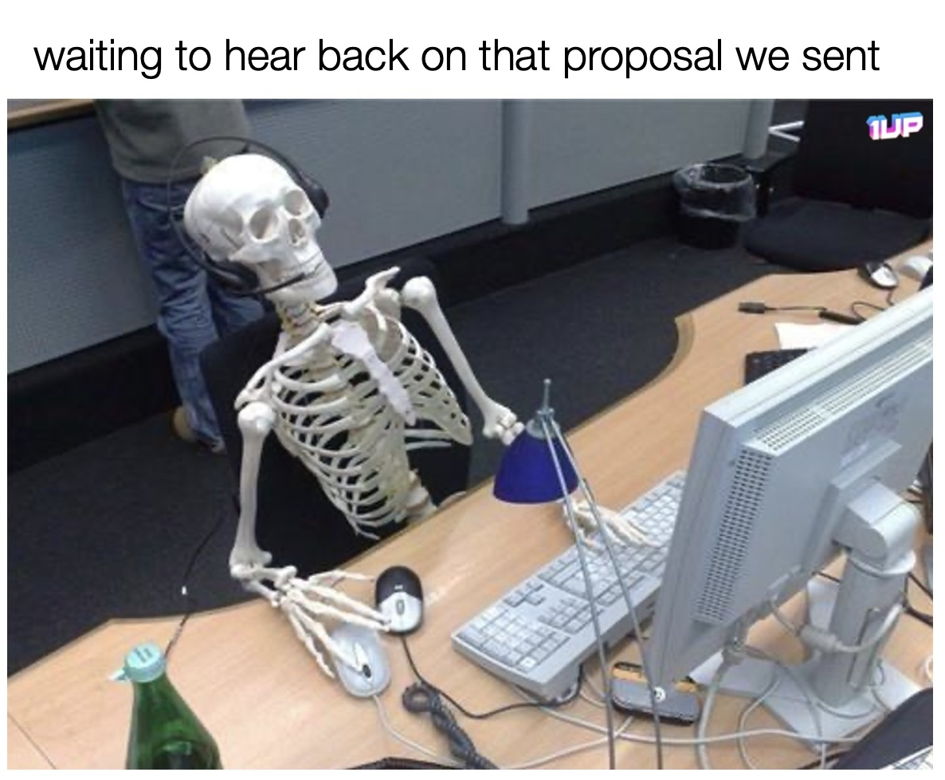
Proposed Solution
Improved Accuracy and Accountability
Centralized data reduces errors and ensures consistent tracking.
Enhanced Audit Readiness
Built-in logging and structured data support internal and external audits.
Scalability and Flexibility
Modular design allows future expansion, including frontend integration or external deployment.
Operational Efficiency
Streamlined asset management reduces manual tracking and improves resource utilization.

Slide 8

Scope
In Scope:
REST API for resource management (no frontend required)
Ability to add, update, delete single or multiple resources
Ability to assign resources to employees or locations
Ability to search resources by type, employee, or location
Role-based permissions (manager vs employee)
Security-first design (authentication, authorization, data protection)
Audit logging for all changes
Hidden Addresses and Names
Out of Scope:
Frontend UI
Employee Management

Slide 9
Assumptions and Dependencies
Assumptions
Dependencies
All employees and managers will have authenticated access to the system via a secure login mechanism.
Managers are responsible for maintaining resource records, including adding, updating, and deleting entries.
Employees will only have read-only access to query resource details and will not be able to modify any data.
Resource categories (e.g., laptops, servers, peripherals) will be predefined and maintained by system administrators.
All resources are assumed to be assigned to either a location or an employee, but not both simultaneously unless explicitly allowed.
IT support must be available for onboarding new users and troubleshooting access or data issues.
Resource acquisition dates must be accurately recorded at the time of entry to ensure proper ID generation.
Authentication and authorization services must be integrated and operational.
Database services must be provisioned and maintained to store and retrieve asset data reliably.
Management must provide clear role definitions to distinguish between employee and manager permissions.
Training and documentation must be provided to ensure users understand how to interact with the system.

Slide 10
Success Criteria
Functional Criteria
Managers can add, update, and delete resources:
Verified through CRUD operation tests.
Measured by error-free execution and correct database updates.
Employees can query resource details:
Queries return accurate and complete information.
Resources can be tracked by employee or location:
Ability to filter and generate reports by employee or location.
Reports match actual database records.
Security Criteria
Database is secure against common attacks:
No vulnerabilities to SQL Injection or Cross-Site Scripting (XSS).
Data Protection:
Sensitive fields (e.g., employee assignments) encrypted at rest and in transit.
Access control enforced based on user roles.

Slide 11
Success Criteria
Quality Assurance
Passes Whole Test Suite:
All unit, integration, and end-to-end tests pass successfully.
Test coverage includes edge cases (invalid input, duplicate IDs).
Performance Benchmarks:
Handles expected load (e.g., 10,000 resources) without degradation.
Response time under peak load remains below 3 seconds.
Compliance and Audit
Meets internal security standards and regulatory requirements.
Audit logs capture all changes with timestamps and user IDs.

Slide 12

Stakeholders
User Proximity | Role | Description
Primary | Managers | Manage asset lifecycle: adding, updating, deleting, and assigning resources.
Primary | Employee | Can view assets assigned to them or query general resource information.
Secondary | System Administrator | Handle deployment, access control, and security management.
Secondary | Developers (Team Blue) | Responsible for designing, implementing, and securing the API.
Secondary | Internal Audit Department | Primary requestor; uses the system to verify inventory and audit changes.
Secondary | Legal Team | Provides guidelines for regulatory and legal compliance.

Slide 13

Risk™s and Mitigation
Risk | Likelihood | Impact | Mitigation
SQL Injection attack | Medium | Critical | Use parameterized queries, Input validation, and regular security scans.
Cross-Site Scripting (XSS) | Medium | High | Encode output, sanitize user Input, implement CSP Headers.
Unauthorized access to resource data | Low | Critical | Role-based access control, Strong authentication, Encryption at rest & transit
Performance degradation under load | Medium | Moderate | Load testing, caching strategies, scalable architecture.
Risk | Likelihood | Impact | Mitigation

Slide 14
Appendices

